Slide 1
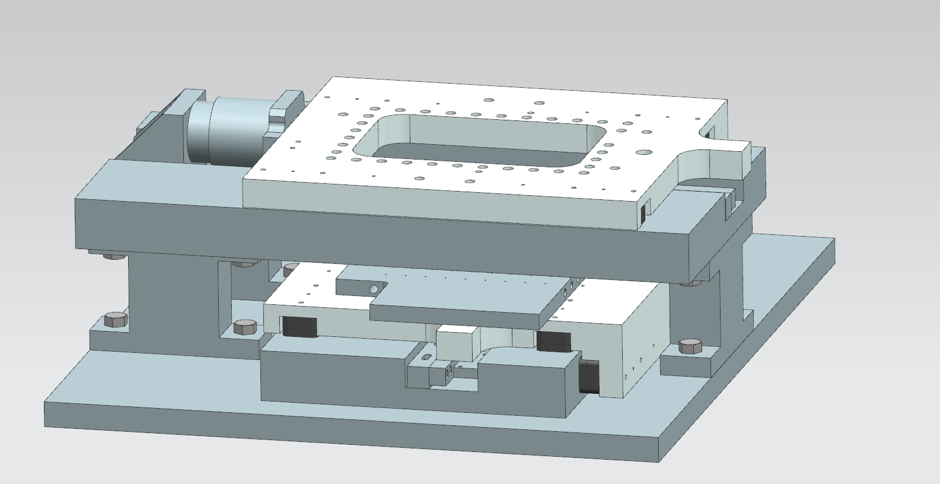
Overview of the two-axis air bearing stage that will be used in the second phase of the student challenge in 2021
The flexure mechanism built using Mechblocks
would be attached to this platform (Tool platform)
x
y
The material to be scribed will be placed on this surface
(specimen platform)

Slide 2
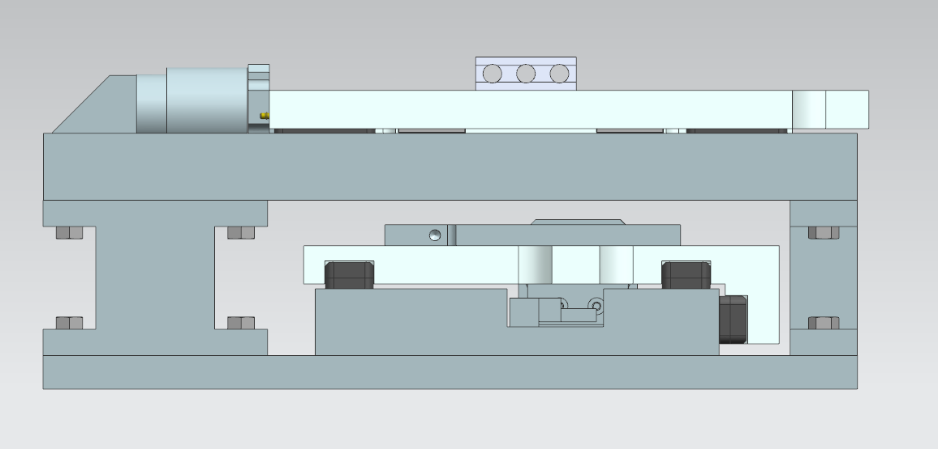
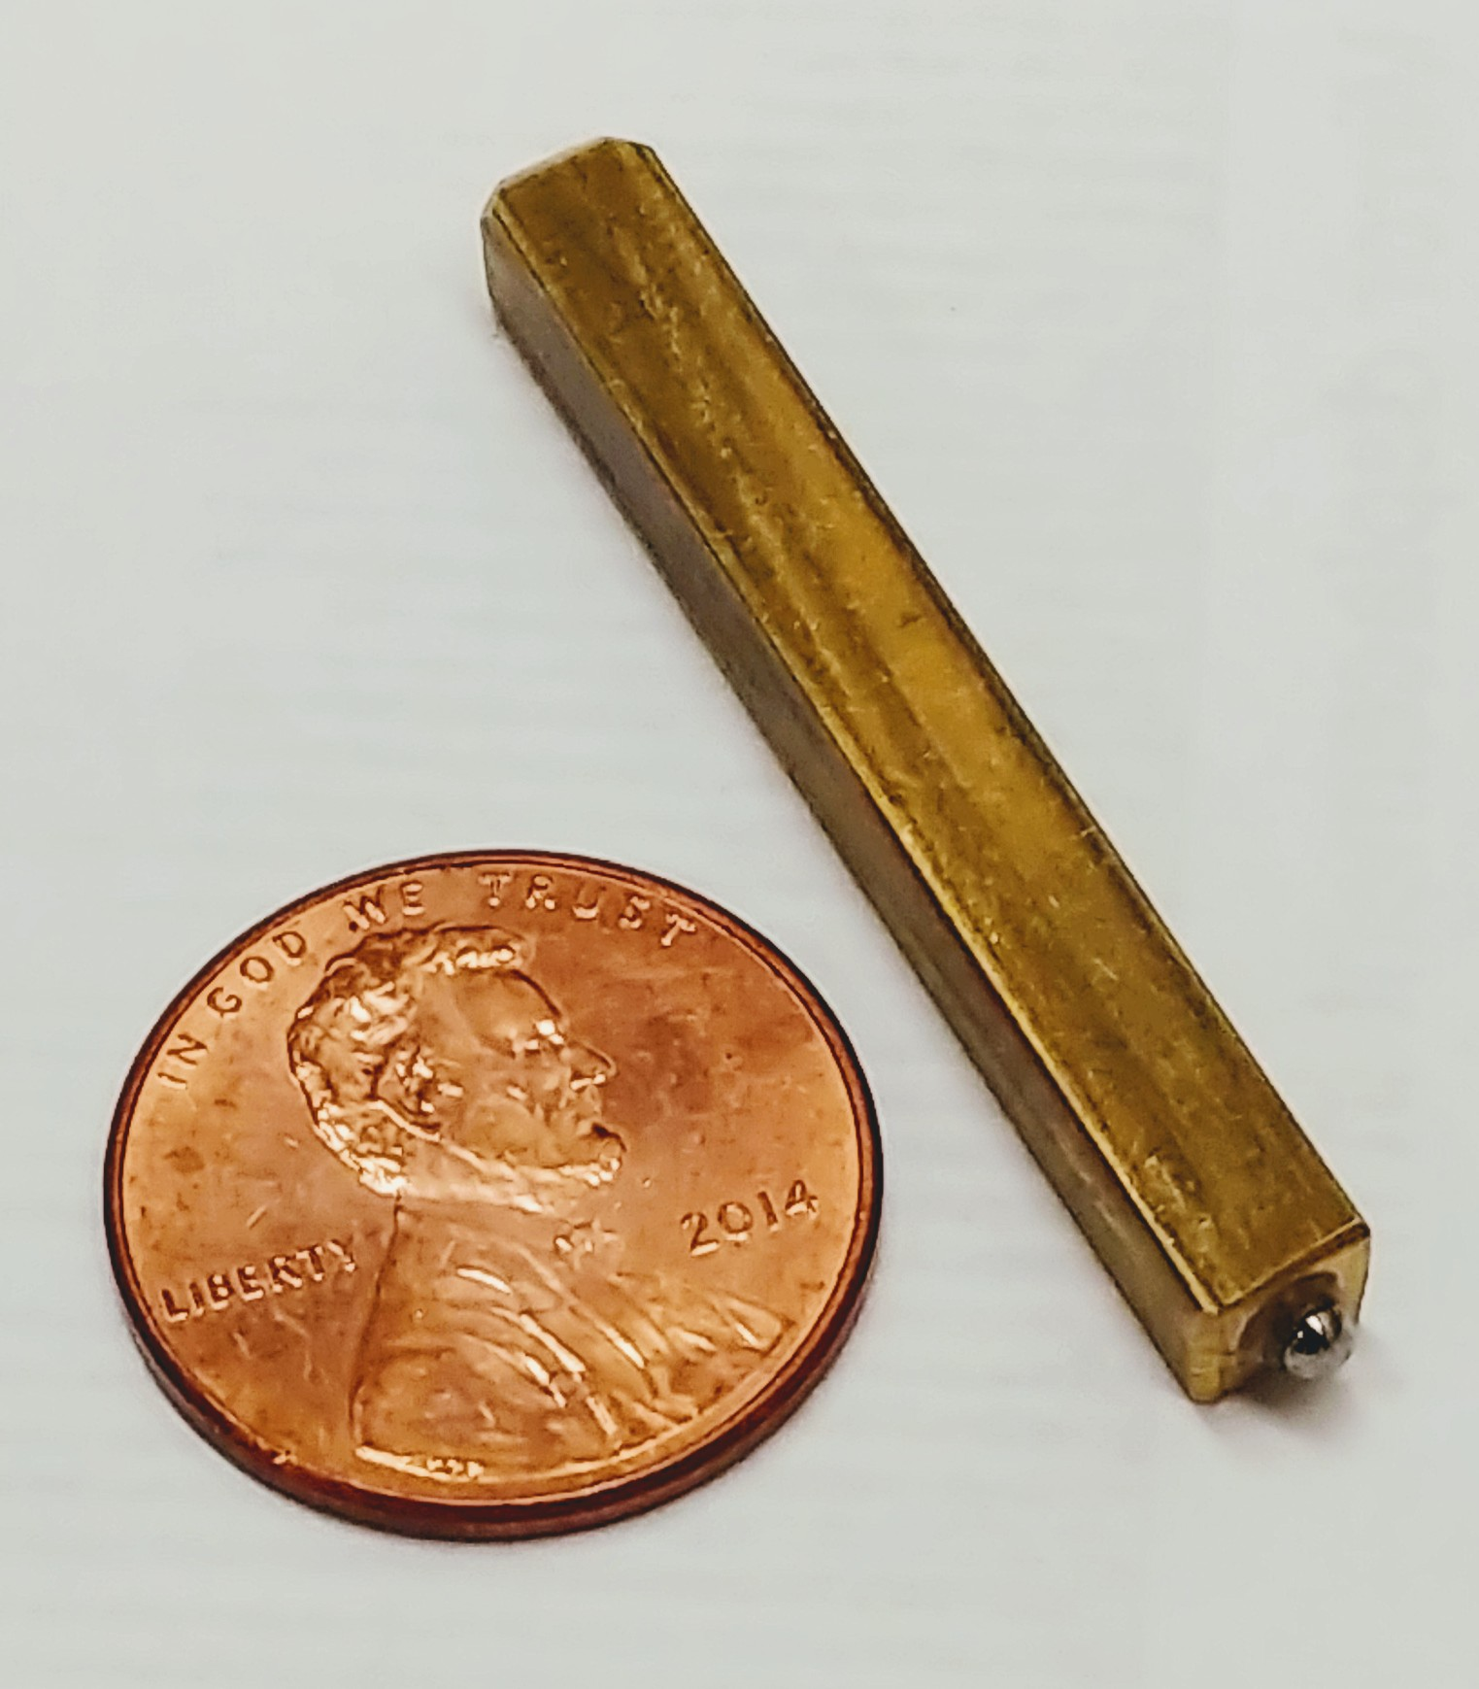
Dimensional constrain of the flexure mechanism to be designed in 2020
Dummy scribe tool provided this year
51 mm
specimen platform
The scribe tool mechanism must be designed in a way that the scribe tool makes contact at the specimen platform

Slide 3
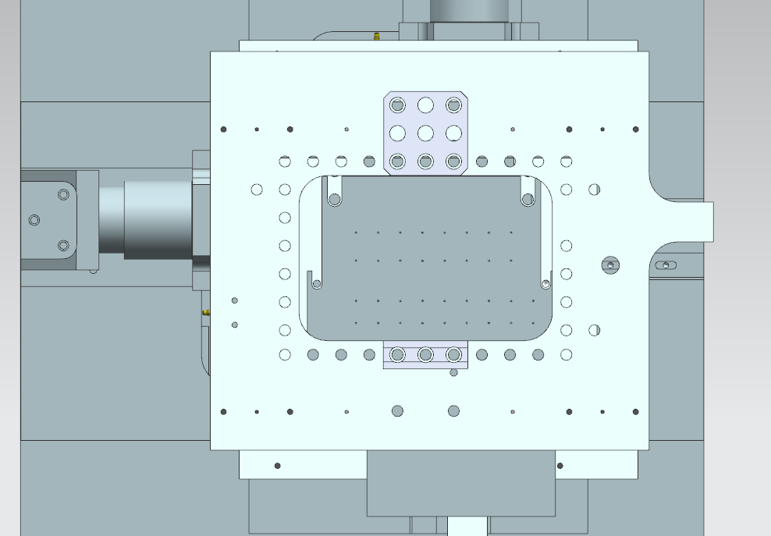
Dimensional constrain of the flexure mechanism to be designed in 2020
74.55 mm
An example showing how the Mech blocks could be attached to the tool platform
114.3 mm
A solid model of the XY stage will be provided to the teams.
Teams must provide a solid model assembly demonstrating that their designed scribe tool mechanism could be assembled into the XY stage.

